Slide 1
Train Reservation System
Mak
Presented by Mak Group
Group Members: Azfar Waqas Ibrar Ul Hassan Atta Ur Rehman
Reg No: UW-23-CY-BS-013 UW-23-CY-BS-018 UW-23-CY-BS-014

Slide 2
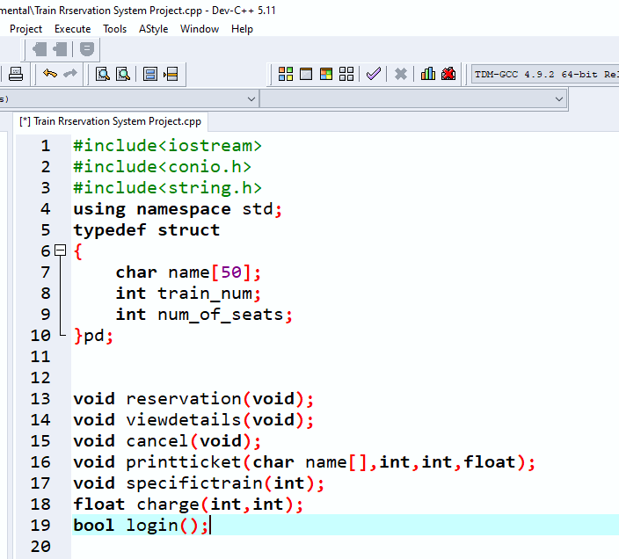
Introduction
Mak

Slide 3
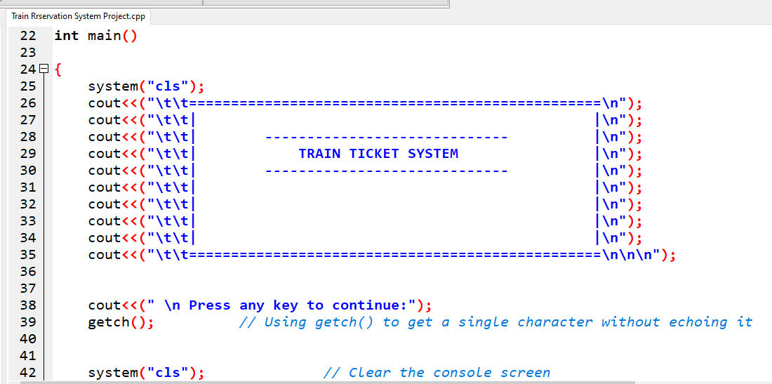
Problem Statement
Mak

Slide 4
Related Work
Mak
In examining the landscape of railway registration systems, it's crucial to understand existing solutions and draw inspiration from various domains to create an innovative Railway Registration System.
Legacy Railway System
Speed
Efficiency
Online Booking Platforms
Room for improvement

Slide 5
Novelty
Mak
Efficient User Interface
RealTime Book and Updates
Personalized Passenger Profiles
Passengers can easily navigate the system reducing the time required for registration.
Implementation of a real-time booking system that provides instant updates on seat availability, train schedules, and registration status
Creation of passenger profiles within the system, storing travel preferences and personal details securely.
Enhanced Security Measures
Feedback
Improvement Mechanism
Implementation of advanced security protocols to safeguard passenger information and transaction data. The system will prioritize data privacy and ensure a secure environment for online transactions.
Allowing passengers to provide input on their registration experience
Improvement based on user feedback ensures a dynamic and responsive system.

Slide 6
THANK YOU!
Mak
Presented by Mak Group

